Slide 1
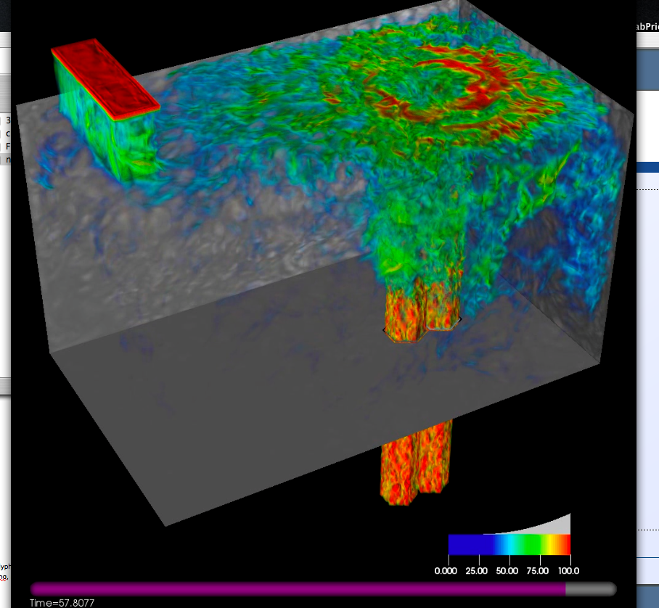
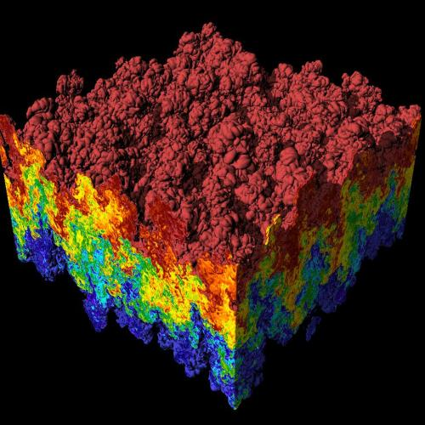
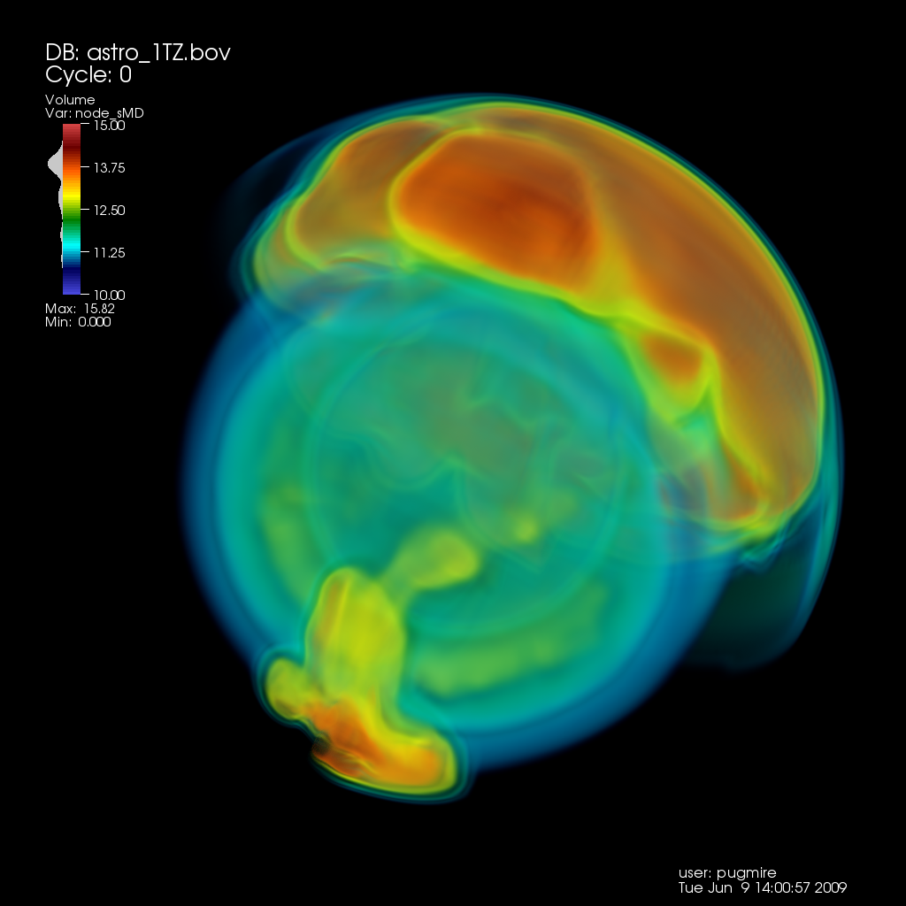
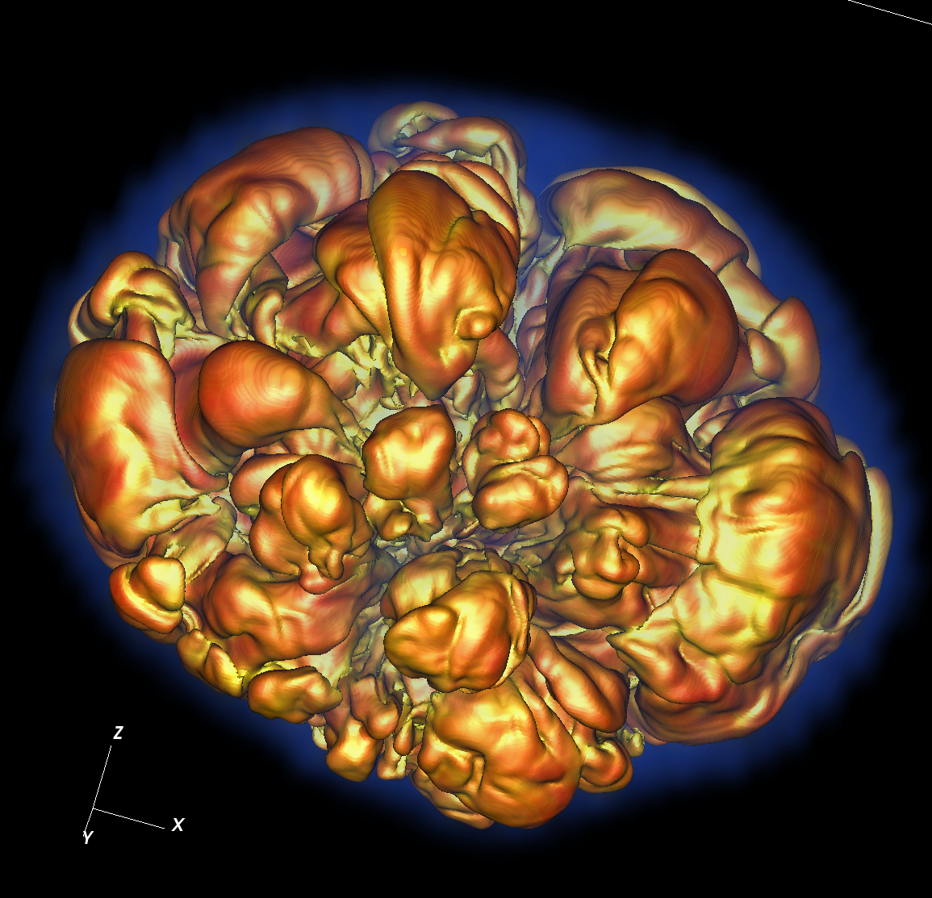
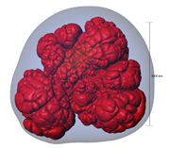
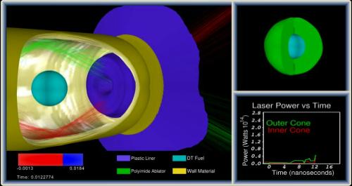
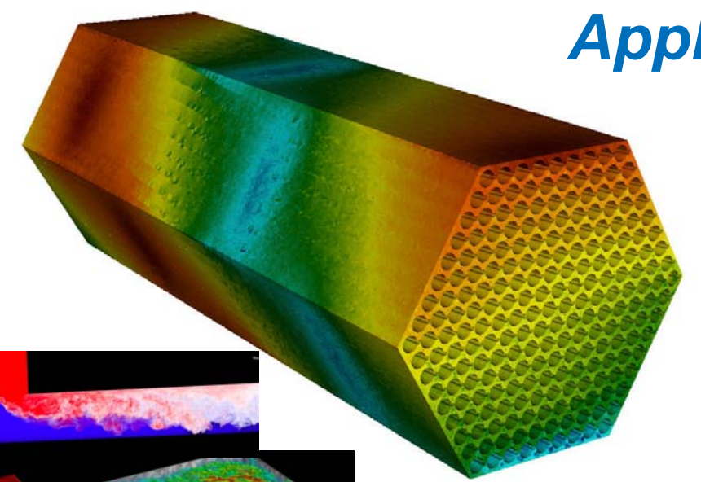
CIS 441/541: Intro to Computer Graphics Lecture 4: Interpolation
January 15, 2019
Hank Childs, University of Oregon

Slide 2
Announcements

Slide 3
No Class Thursday
And no more YouTube lectures coming this week
We have what we need for 1C. I would prefer to time extra content for 1D/1E/1F around their due dates.

Slide 4
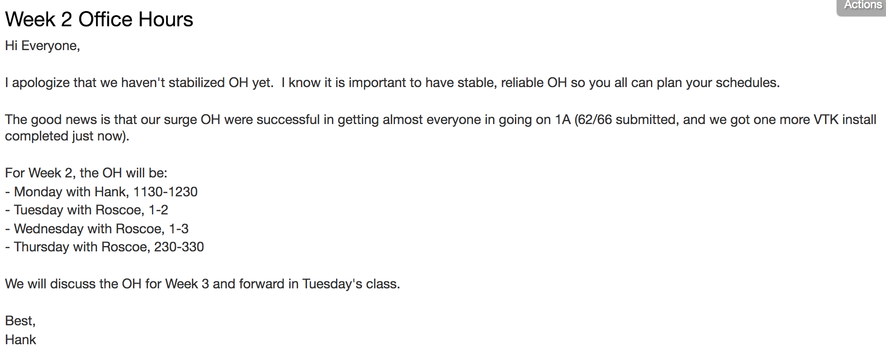
Week 2 Office Hours

Slide 5
Office Hours: Weeks 3-10
Monday: 1-2 (Roscoe)
Tuesday: 1-2 (Roscoe)
Wednesday: 1-3 (Roscoe)
Thursday: WHEN? (Hank)
Friday: WHEN? (Hank)

Slide 6
Some Sample Final Projects

Slide 7
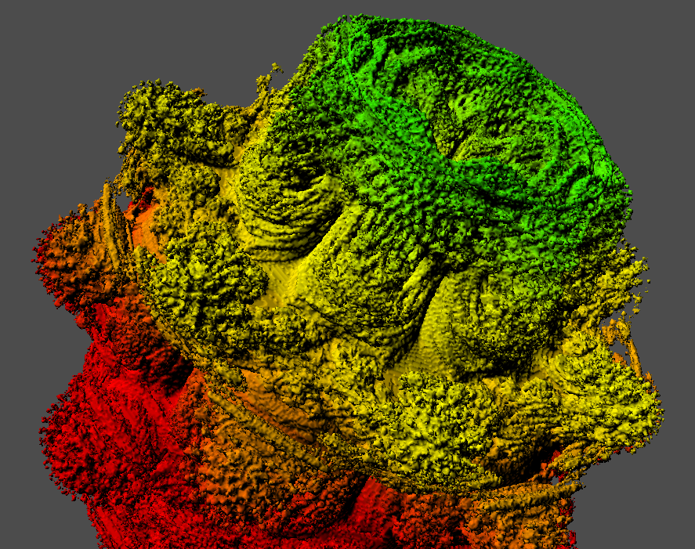
Questions About Final Projects

Slide 8
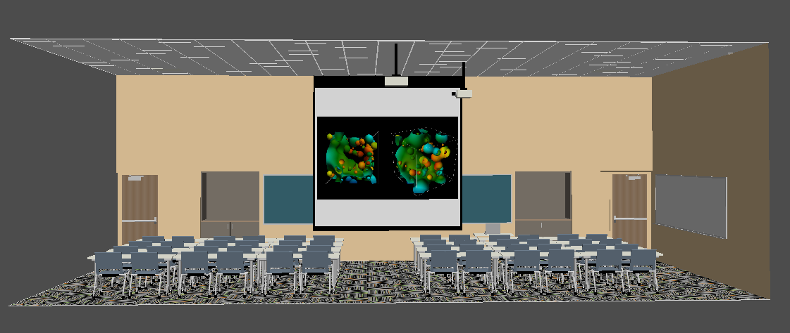
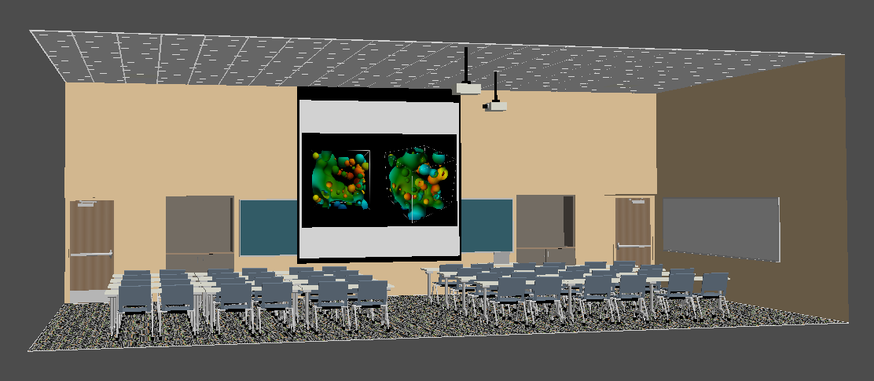

Slide 9
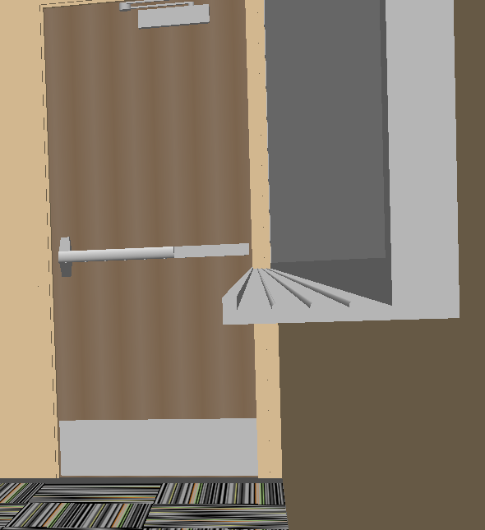
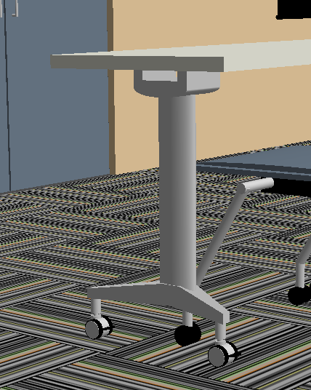

Slide 10
Quick Review

Slide 11
What Are We Rendering?
Models made up of polygons
Usually triangles
Lighting tricks make surfaces look non-faceted
More on this later…

Slide 12
NEW Slide
Multiple coordinate spaces
“World space”
Specify an origin and locations with respect to that origin
(x,y,z)
“Screen space”
Everything relative to pixels on the screen
Triangle vertex (10.5, 20.5) lies in pixel (10, 20)

Slide 13
NEW Slide
Later, we will figure out how to:
Define a camera position
Transform triangle vertices from world space to screen space
Currently: assuming the transform has happened, and operating on triangle vertices already in screen space

Slide 14
The middle and lower-left variants are half-pixel translations of the other
We will use the lower-left convention for the projects.
Pixel center
Lower left of pixel

Slide 15
Problem: how to deposit triangle colors onto an image?
Let’s take an example:
12x12 image
Red triangle
Vertex 1: (2.5, 1.5)
Vertex 2: (2.5, 10.5)
Vertex 3: (10.5, 1.5)
Vertex coordinates are with respect to pixel locations

Slide 16
(0,12)
(12,12)
(2.5,10.5)
(2.5,1.5)
(10.8,1.5)
(0,0)
(12,0)

Slide 17
Our desired output
How do we make this output? Efficiently?

Slide 18
Scanline algorithm: consider all rows that can possibly overlap
We will extract a “scanline”, i.e. calculate the intersections for one row of pixels
Don’t need to consider any
Pixels outside these lines
X
X
X
X
X
Y=5

Slide 19
Red triangle
Vertex 1: (2.5, 1.5)
Vertex 2: (2.5, 10.5)
Vertex 3: (10.5, 1.5)

Slide 20
Red triangle
Vertex 1: (2.5, 1.5)
Vertex 2: (2.5, 10.5)
Vertex 3: (10.5, 1.5)
Y=5

Slide 21
Red triangle
Vertex 1: (2.5, 1.5)
Vertex 2: (2.5, 10.5)
Vertex 3: (10.5, 1.5)
Y=5
What are the end points?

Slide 22
Red triangle
Vertex 1: (2.5, 1.5)
Vertex 2: (2.5, 10.5)
Vertex 3: (10.5, 1.5)
Y=5
(2.5, 5)
What are the end points?

Slide 23
Red triangle
Vertex 1: (2.5, 1.5)
Vertex 2: (2.5, 10.5)
Vertex 3: (10.5, 1.5)
Algebra!
Y=5
(2.5, 5)
What are the end points?

Slide 24
Red triangle
Vertex 1: (2.5, 1.5)
Vertex 2: (2.5, 10.5)
Vertex 3: (10.5, 1.5)
Y = mx+b
10.5=m*2.5+b
1.5 = m*10.5+b
→
9 = -8m
m = -1.125
b = 13.3125
5 = -1.125*x + 13.3125
x = 7.3888
Algebra!
Y=5
(2.5, 5)
What are the end points?

Slide 25
Scanline algorithm: consider all rows that can possibly overlap
Don’t need to consider any
Pixels outside these lines
2.5
X
X
X
X
X
7.3888
Y=5

Slide 26
Scanline algorithm: consider all rows that can possibly overlap
Don’t need to consider any
Pixels outside these lines
2.5
X
X
X
X
X
7.3888
Y=5
Color is deposited at (3,5), (4,5), (5,5), (6,5), (7,5)

Slide 27
Scanline algorithm
Determine rows of pixels triangles can possibly intersect
Call them rowMin to rowMax
rowMin: ceiling of smallest Y value
rowMax: floor of biggest Y value
For r in [rowMin → rowMax] ; do
Find end points of r intersected with triangle
Call them leftEnd and rightEnd
For c in [ceiling(leftEnd) → floor(rightEnd) ] ; do
ImageColor(r, c) ← triangle color

Slide 28
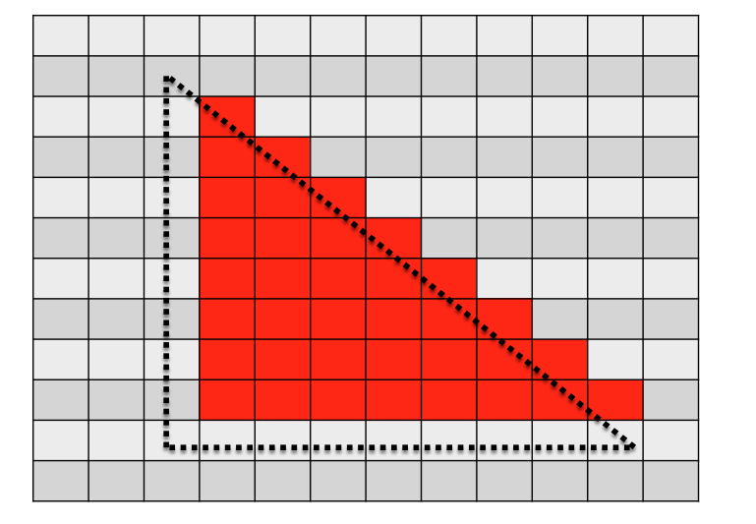
Scanline algorithm
Determine rows of pixels triangles can possibly intersect
For r in [rowMin → rowMax] ; do
Find end points of r intersected with triangle
Call them leftEnd and rightEnd
For c in [ceiling(leftEnd) → floor(rightEnd) ] ; do
ImageColor(r, c) ← triangle color
Y values from 1.5 to 10.5
mean rows 2 through 10
For r = 5, leftEnd = 2.5,
rightEnd = 7.3888
For r = 5, we call ImageColor with
(5,3), (5,4), (5,5), (5,6), (5,7)

Slide 29
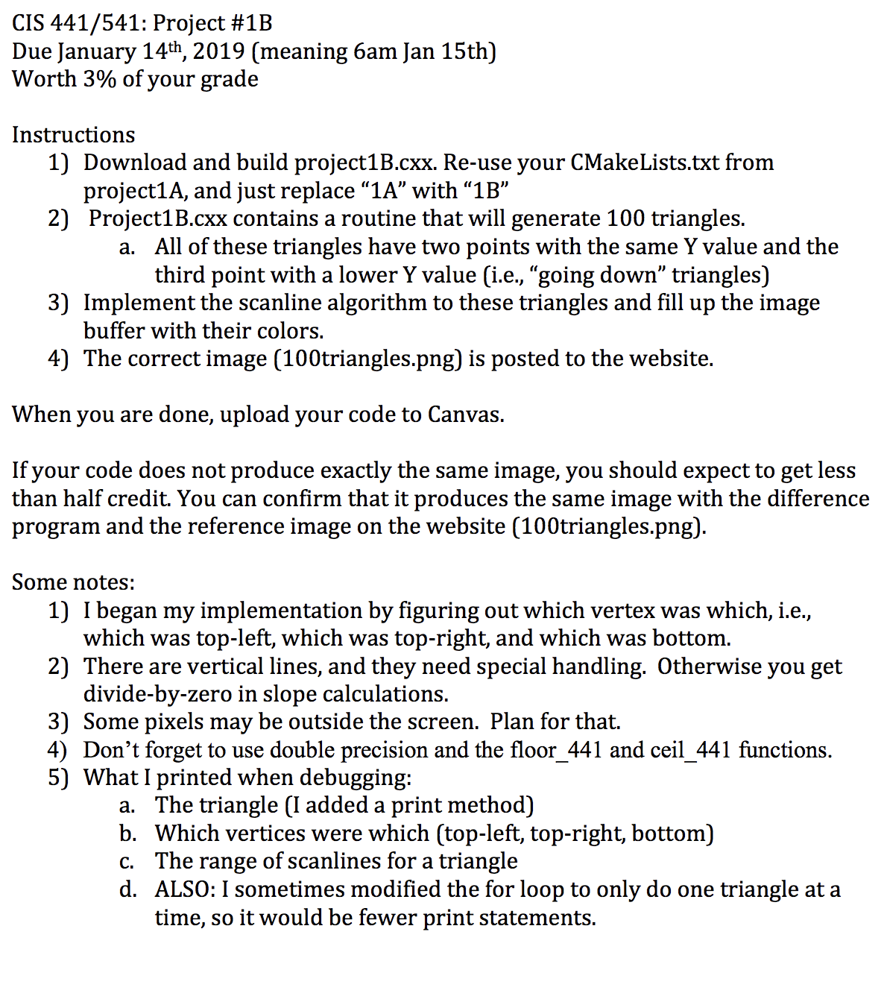
Project 1B (due last night): Questions?

Slide 30
End Review

Slide 31
Arbitrary Triangles
The description of the scanline algorithm in the preceding slides is general.
But the implementation for these three triangles vary:

Slide 32
Arbitrary Triangles
Project #1B: implement the scanline algorithm for “going down” triangles
Project #1C: arbitrary triangles

Slide 33
Arbitrary Triangles
Function: RasterizeGoingDownTriangle
(You have this from 1B)
Function: RasterizeGoingUpTriangle
(You can write this by modifying RasterizeGoingDownTriangle)
Function: RasterizeArbitraryTriangle
Split into two triangles
Call RasterizeGoingUpTriangle and RasterizeGoingDownTriangle

Slide 34

Project #1C (6%), Due (Jan 23rd)
Goal: apply the scanline algorithm to arbitrary triangles and output an image.
Extend your project1B code
File proj1c_geometry.vtk available on web (80MB)
File “reader.cxx” has code to read triangles from file.
No Cmake, project1c.cxx

Slide 35
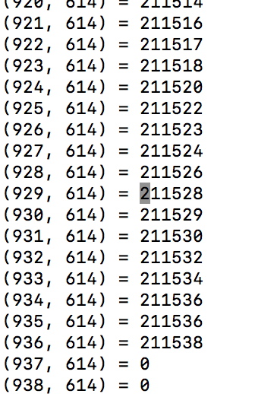
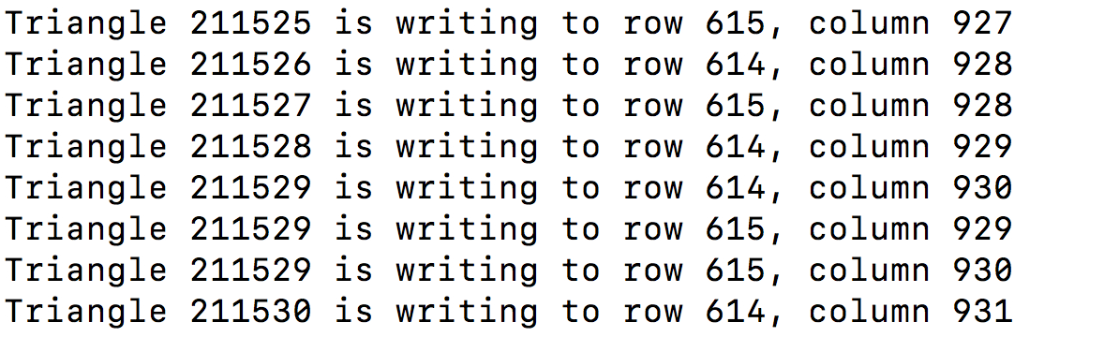
File triangle_ids
Output from my program

Slide 36
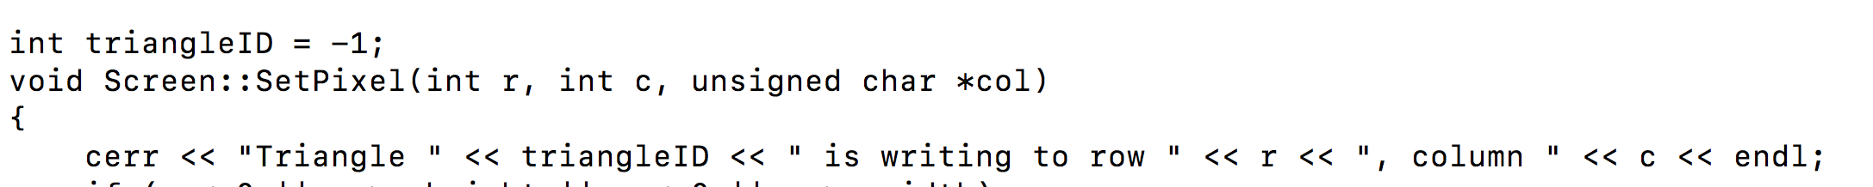
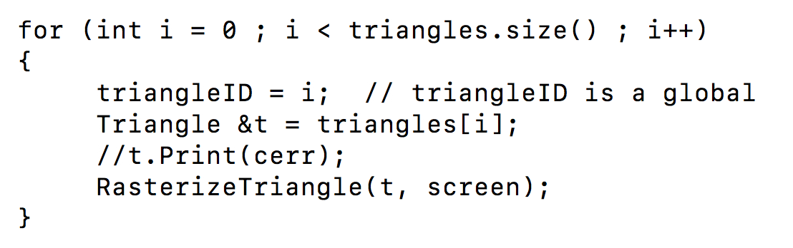
How did I get my output?

Slide 37
Negative Y values

Slide 38
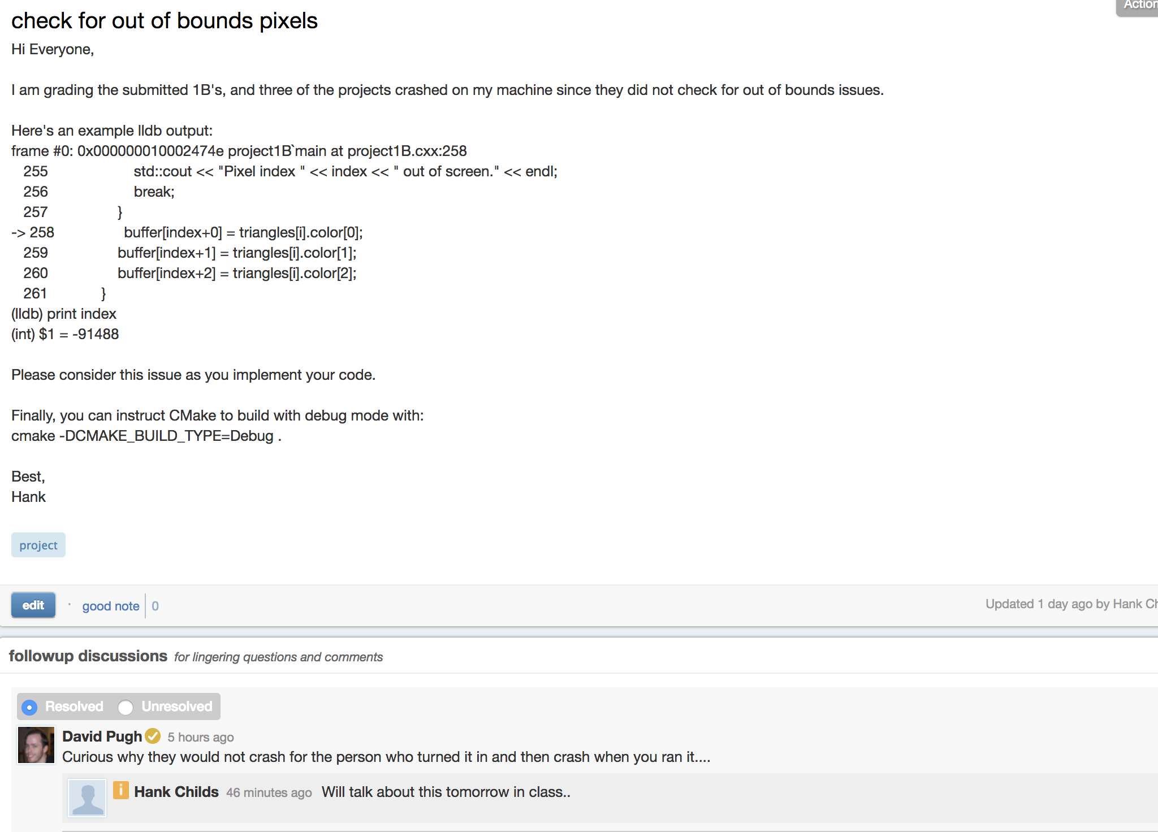

Slide 39
Where we are…
We haven’t talked about how to get triangles into position.
Arbitrary camera positions through linear algebra
We haven’t talked about shading
On Thursday, we tackled this problem:
How to deposit triangle colors onto an image?
Still don’t know how to:
Vary colors (easy)
Deal with triangles that overlap
Today’s lecture will go over the key operation to do these two.

Slide 40
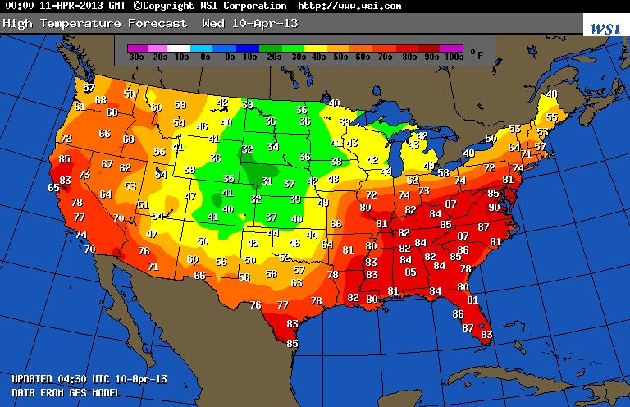
What is a field?
Example field (2D): temperature over the United States

Slide 41
How much data is needed to make this picture?
Example field (2D): temperature over the United States

Slide 42
Linear Interpolation for Scalar Field F
F(A)
F(X)
F(B)
A
X
B

Slide 43
Linear Interpolation for Scalar Field F
General equation to interpolate:
F(X) = F(A) + t*(F(B)-F(A))
t is proportion of X between A and B
t = (X-A)/(B-A)
F(A)
F(X)
F(B)
A
X
B

Slide 44
Quiz Time #4
F(3) = 5, F(6) = 11
What is F(4)?
= 5 + (4-3)/(6-3)*(11-5) = 7
General equation to interpolate:
F(X) = F(A) + t*(F(B)-F(A))
t is proportion of X between A and B
t = (X-A)/(B-A)

Slide 45
Consider a single scalar field defined on a triangle.
Y-axis
Y=1
Y=0.5
X-axis
Y=0
X=0
X=0.5
X=1
X=1.5
X=2

Slide 46
Consider a single scalar field defined on a triangle.
Y-axis
V2
Y=1
F(V2) = 2
Y=0.5
V1
V3
F(V1) = 10
F(V3) = -2
X-axis
Y=0
X=0
X=0.5
X=1
X=1.5
X=2

Slide 47
What is F(V4)?
Y-axis
V2
Y=1
F(V2) = 2
Y=0.5
V4, at (0.5, 0.25)
V1
V3
F(V1) = 10
F(V3) = -2
X-axis
Y=0
X=0
X=0.5
X=1
X=1.5
X=2

Slide 48
What is F(V4)?
Y-axis
V2
Y=1
F(V2) = 2
Y=0.5
V5
V4, at (0.5, 0.25)
V6
V1
V3
F(V1) = 10
F(V3) = -2
X-axis
Y=0
X=0
X=0.5
X=1
X=1.5
X=2

Slide 49
Steps to follow:
Calculate V5, the left intercept for Y=0.25
Calculate V6, the right intercept for Y=0.25
Calculate V4, which is between V5 and V6

Slide 50
What is the X-location of V5?
Y-axis
V2
Y=1
F(V2) = 2
F(v1) = A → F(0) = 0
F(v2) = B → F(1) = 1
F(v) = A + ((v-v1)/(v2-v1))*(B-A):
F(v) = 0.25, find v
0.25 = 0 + ((v-0)/(1-0)*(1-0)
v = 0.25
Y=0.5
V5
V4, at (0.5, 0.25)
V6
V1
V3
F(V1) = 10
F(V3) = -2
X-axis
Y=0
X=0
X=0.5
X=1
X=1.5
X=2

Slide 51
What is the F-value of V5?
Y-axis
V2
Y=1
F(V2) = 2
F(v1) = A → F(0) = 10
F(v2) = B → F(1) = 2
F(v) = A + ((v-v1)/(v2-v1))*(B-A):
v = 0.25, find F(v)
F(v) = 10 + ((0.25-0)/(1-0))*(2-10)
= 10 + 0.25*-8 = 10 -2 = 8
Y=0.5
V5
V4, at (0.5, 0.25)
V6
V1
V3
F(V1) = 10
F(V3) = -2
X-axis
Y=0
X=0
X=0.5
X=1
X=1.5
X=2

Slide 52
What is the X-location of V6?
Y-axis
V2
Y=1
F(V2) = 2
F(v1) = A → F(1) = 1
F(v2) = B → F(2) = 0
F(v) = A + ((v-v1)/(v2-v1))*(B-A):
F(v) = 0.25, find v
0.25 = 1 + ((v-1)/(2-1)*(0-1)
= 1 + (v-1)*(-1)
0.25 = 2 - v
v = 1.75
Y=0.5
V5
V4, at (0.5, 0.25)
V6
V1
V3
F(V1) = 10
F(V3) = -2
X-axis
Y=0
X=0
X=0.5
X=1
X=1.5
X=2

Slide 53
What is the F-value of V6?
Y-axis
V2
Y=1
F(V2) = 2
F(v1) = A → F(1) = 2
F(v2) = B → F(2) = -2
F(v) = A + ((v-v1)/(v2-v1))*(B-A):
v = 1.75, find F(v)
F(v) = 2 + ((1.75-1)/(2-1)*(-2 - +2)
= 2 + (.75)*(-4)
= 2 - 3
= -1
Y=0.5
V5
V4, at (0.5, 0.25)
V6
V1
V3
F(V1) = 10
F(V3) = -2
X-axis
Y=0
X=0
X=0.5
X=1
X=1.5
X=2

Slide 54
What is the F-value of V5?
Y-axis
V2
Y=1
Y=0.5
L(V5) = (0.25, 0.25)
F(V5) = 8
L(V6) = (1.75, 0.25)
F(V6) = -1
V5
V4, at (0.5, 0.25)
V6
V1
V3
F(V1) = 10
F(V3) = -2
X-axis
Y=0
X=0
X=0.5
X=1
X=1.5
X=2

Slide 55
What is the F-value of V5?
F(v1) = A → F(0.25) = 8
F(v2) = B → F(1.75) = -1
F(v) = A + ((v-v1)/(v2-v1))*(B-A):
v = 0.5, find F(v)
F(v) = 8 + ((0.5-0.25)/(1.75-0.25))*(-1-8)
= 8 + (0.25/1.5)*9 = 8-1.5 = 6.5
Y-axis
V2
Y=1
Y=0.5
L(V5) = (0.25, 0.25)
F(V5) = 8
L(V6) = (1.75, 0.25)
F(V6) = -1
V5
V4, at (0.5, 0.25)
V6
V1
V3
F(V1) = 10
F(V3) = -2
X-axis
Y=0
X=0
X=0.5
X=1
X=1.5
X=2

Slide 56

Visualization of F
F=10
F=-2
Not defined
How do you think this picture was made?

Slide 57
Now We Understand Interpolation Let’s Use It For Two New Ideas: Color Interpolation & Z-buffer Interpolation

Slide 58
Colors

Slide 59
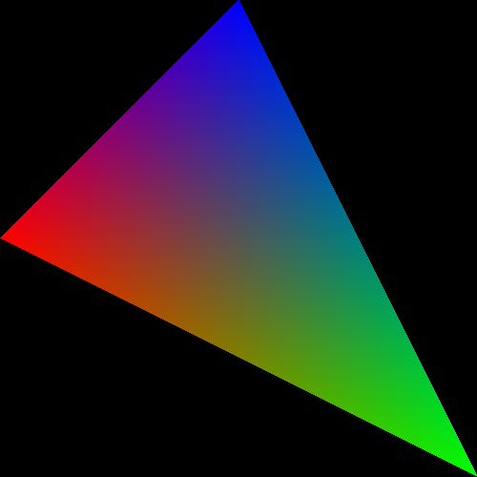
What about triangles that have more than one color?

Slide 60


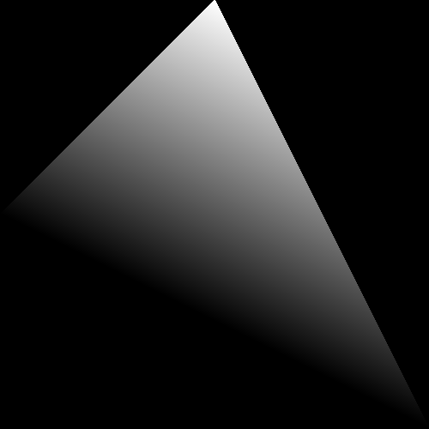
The color is in three channels, hence three scalar fields defined on the triangle.
Red channel
Green channel
Blue channel

Slide 61
Scanline algorithm
Determine rows of pixels triangles can possibly intersect
Call them rowMin to rowMax
rowMin: ceiling of smallest Y value
rowMax: floor of biggest Y value
For r in [rowMin → rowMax] ; do
Find end points of r intersected with triangle
Call them leftEnd and rightEnd
For c in [ceiling(leftEnd) → floor(rightEnd) ] ; do
ImageColor(r, c) ← triangle color

Slide 62
Scanline algorithm w/ Color
Determine rows of pixels triangles can possibly intersect
Call them rowMin to rowMax
rowMin: ceiling of smallest Y value
rowMax: floor of biggest Y value
For r in [rowMin → rowMax] ; do
Find end points of r intersected with triangle
Call them leftEnd and rightEnd
Calculate Color(leftEnd) and Color(rightEnd) using interpolation from triangle vertices
For c in [ceiling(leftEnd) → floor(rightEnd) ] ; do
Calculate Color(r, c) using Color(leftEnd) and Color(rightEnd)
ImageColor(r, c) ← Color(r, c)

Slide 63
Simple Example
V(2,2)
RGB = (0,1,0)
V(1,1)
V(2,1)
V(3,1)
RGB = (0.5,0.5,0)
RGB = (0.25,0.5,0.25)
RGB = (0,0.5,0.5)
V(0,0)
V(4,0)
RGB = (1,0,0)
What is the color at (2, 1)?
RGB = (0,0,1)

Slide 64
Scanline algorithm w/ Color
Determine rows of pixels triangles can possibly intersect
Call them rowMin to rowMax
rowMin: ceiling of smallest Y value
rowMax: floor of biggest Y value
For r in [rowMin → rowMax] ; do
Find end points of r intersected with triangle
Call them leftEnd and rightEnd
Calculate Color(leftEnd) and Color(rightEnd) using interpolation from triangle vertices
For c in [ceiling(leftEnd) → floor(rightEnd) ] ; do
Calculate Color(r, c) using Color(leftEnd) and Color(rightEnd)
ImageColor(r, c) ← Color(r, c)
Calculating multiple color channels here!

Slide 65
Important
ceiling / floor: needed to decide which pixels to deposit colors to
used: rowMin / rowMax, leftEnd / rightEnd
not used: when doing interpolation
Color(leftEnd) and Color(rightEnd) should be at the intersection locations … no ceiling/floor.

Slide 66
How To Resolve When Triangles Overlap: The Z-Buffer

Slide 67
Imagine you have a cube where each face has its own color….
Face | Color
Front | Blue
Right | Green
Top | Red
Back | Yellow
Left | Purple
Bottom | Cyan
View from “front/top/right” side

Slide 68
Imagine you have a cube where each face has its own color….
How do we render the pixels that we want and ignore the pixels from faces that are obscured?
View from “front/top/right” side
View from “back/bottom/left” side

Slide 69
Consider a scene from the right side
Face | Color
Front | Blue
Right | Green
Top | Red
Back | Yellow
Left | Purple
Bottom | Cyan
Camera/eyeball
Camera oriented directly at Front face,
seen from the Right side

Slide 70
Consider the scene from the top side
Face | Color
Front | Blue
Right | Green
Top | Red
Back | Yellow
Left | Purple
Bottom | Cyan
Camera/eyeball
Camera oriented directly at Front face,
seen from the Top side

Slide 71
What do we render?
Green, Red, Purple, and Cyan all “flat” to camera. Only need to render Blue and Yellow faces (*).
Face | Color
Front | Blue
Right | Green
Top | Red
Back | Yellow
Left | Purple
Bottom | Cyan
Camera/eyeball
Camera oriented directly at Front face,
seen from the Top side

Slide 72
What do we render?
What should the picture look like?
What’s visible? What’s obscured?
Face | Color
Front | Blue
Right | Green
Top | Red
Back | Yellow
Left | Purple
Bottom | Cyan
Camera/eyeball
Camera oriented directly at Front face,
seen from the Top side

Slide 73
New field associated with each triangle: depth
Project 1B,1C:
class Triangle
{
public:
Double X[3];
Double Y[3];
…
};
Now…
Double Z[3];

Slide 74
What do we render?
Z=0
Z=-1
Face | Color
Front | Blue
Right | Green
Top | Red
Back | Yellow
Left | Purple
Bottom | Cyan
Camera/eyeball
Camera oriented directly at Front face,
seen from the Top side

Slide 75
Using depth when rendering
Use Z values to guide which geometry is displayed and which is obscured.
Example….

Slide 76
Consider 4 triangles with constant Z values
Z=-0.35
Z=-0.5
Z=-0.65
Z=-0.8

Slide 77
Consider 4 triangles with constant Z values
How do we make this picture?
Z=-0.35
Z=-0.5
Z=-0.65
Z=-0.8

Slide 78
Idea #1
Sort triangles “back to front” (based on Z)
Render triangles in back to front order
Overwrite existing pixels

Slide 79
Idea #2
Sort triangles “front to back” (based on Z)
Render triangles in front to back order
Do not overwrite existing pixels.

Slide 80
But there is a problem…
(0, 1, -0.4)
(0, 1.5, -0.4)
(-1, -1, -0.3)
(1, -1, -0.5)
(-2, -1.5, -0.5)
(2, -1.5, -0.3)

Slide 81
The Z-Buffer Algorithm
The preceding 10 slides were designed to get you comfortable with the notion of depth/Z.
The Z-Buffer algorithm is the way to deal with overlapping triangles when doing rasterization.
It is the technique that GPUs use.
It works with opaque triangles, but not transparent geometry, which requires special handling
Transparent geometry discussed week 7.
Uses the front-to-back or back-to-front sortings just discussed.

Slide 82
The Z-Buffer Algorithm: Data Structure
Existing: for every pixel, we store 3 bytes:
Red channel, green channel, blue channel
New: for every pixel, we store a floating point value:
Depth buffer (also called “Z value”)
Now 7 bytes per pixel (*)
(*): 8 with RGBA

Slide 83
The Z-Buffer Algorithm: Initialization
Existing:
For each pixel, set R/G/B to 0.
New:
For each pixel, set depth value to -1.
Valid depth values go from -1 (back) to 0 (front)
This is partly convention and partly because it “makes the math easy” when doing transformations.

Slide 84
Scanline algorithm
Determine rows of pixels triangles can possibly intersect
Call them rowMin to rowMax
rowMin: ceiling of smallest Y value
rowMax: floor of biggest Y value
For r in [rowMin → rowMax] ; do
Find end points of r intersected with triangle
Call them leftEnd and rightEnd
For c in [ceiling(leftEnd) → floor(rightEnd) ] ; do
ImageColor(r, c) ← triangle color

Slide 85
Scanline algorithm w/ Z-Buffer
Determine rows of pixels triangles can possibly intersect
Call them rowMin to rowMax
rowMin: ceiling of smallest Y value
rowMax: floor of biggest Y value
For r in [rowMin → rowMax] ; do
Find end points of r intersected with triangle
Call them leftEnd and rightEnd
Interpolate z(leftEnd) and z(rightEnd) from triangle vertices
For c in [ceiling(leftEnd) → floor(rightEnd) ] ; do
Interpolate z(r,c) from z(leftEnd) and z(rightEnd)
If (z(r,c) > depthBuffer(r,c))
ImageColor(r, c) ← triangle color
depthBuffer(r,c) = z(r,c)

Slide 86
The Z-Buffer Algorithm: Example
(0,12)
(12,12)
(2.5,10.5, -0.25)
Y=5
(2.5,2.5, -0.5)
(10.5,2.5, -1)
(0,0)
(12,0)

Slide 87
The Z-Buffer Algorithm: Example
(0,12)
(12,12)
(6.3, 8.5, -0.75)
Y=5
(1.3,3.5, -1)
(11.3, 3.5, -0.5)
(0,0)
(12,0)

Slide 88
Interpolation and Triangles
We introduced the notion of interpolating a field on a triangle
We used the interpolation in two settings:
1) to interpolate colors
2) to interpolate depths for z-buffer algorithm
Project 1D: you will be adding color interpolation and the z-buffer algorithm to your programs.

